Slide 1

AGILE METHODOLGIES
Ananya K S

Slide 2


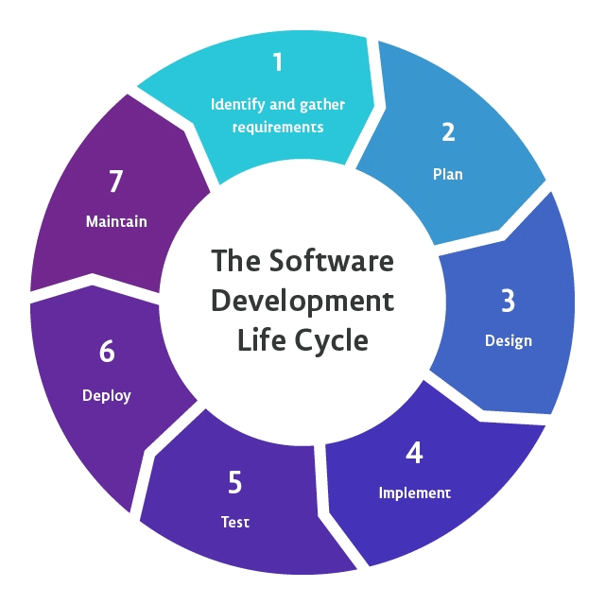
Software Development Lifecycle
What is Software Development Lifecycle?
SDLC

Slide 3

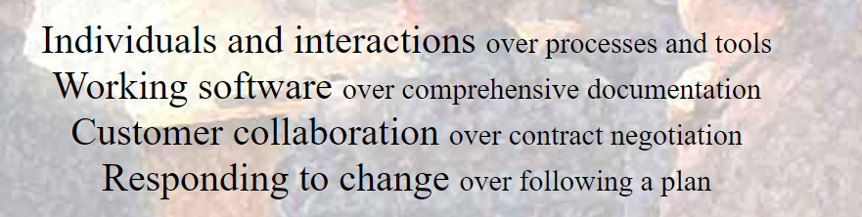
AGILE
Ken Schwaber and Jeff Sutherland.
Agile manifesto - 2001
Snowbird, Utah
Agile - ability to move quickly and easily.
Agile has 4 manifestos and 12 principles.

Slide 4





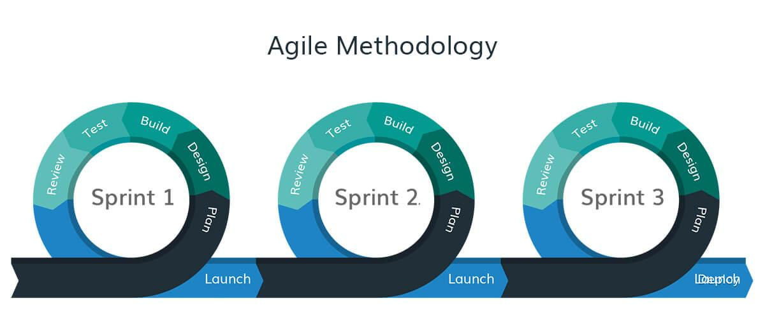

What is Agile?

Slide 5

Why Agile?
Waterfall methodology

Slide 6
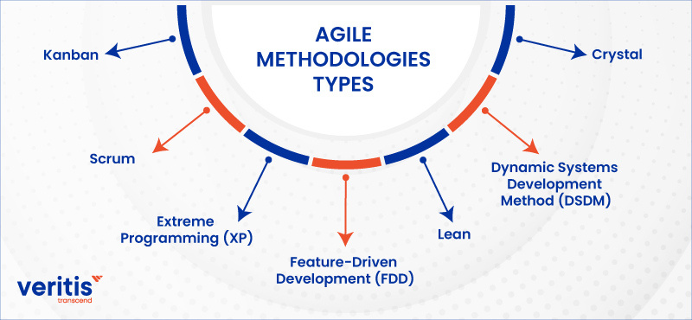
Agile Methodologies

Slide 7


Scrum vs Kanban

Slide 8

Agile Terminologies
Product backlog
Product Owner
Scrum master
Team members
Sprint backlog
Burndown
Sprint planning
Sprint review
Daily scrum
As a (role), I need a (feature) , so that (reason for the need)

Slide 9






Tools
Jira
Slack
Icescrum
Trello
Figma

Slide 10
THANK YOU

